Slide 1
Chapter 5
CS435: Introduction to Software Engineering
Dr. M. Zhu
Understanding Requirements
Slide Set to accompany
Software Engineering: A Practitioner’s Approach, 7/e
by Roger S. Pressman
Slides copyright © 1996, 2001, 2005, 2009 by Roger S. Pressman
For non-profit educational use only
May be reproduced ONLY for student use at the university level when used in conjunction with Software Engineering: A Practitioner's Approach, 7/e. Any other reproduction or use is prohibited without the express written permission of the author.
All copyright information MUST appear if these slides are posted on a website for student use.
These slides are designed to accompany Software Engineering: A Practitioner’s Approach, 7/e (McGraw-Hill, 2009). Slides copyright 2009 by Roger Pressman.
1

Slide 2
Requirements Engineering
Many software developers want to jump right in building software before they have a clear understanding of what is needed. They argue that things will become clear as they build, that project stakeholders will be able to understand need only after examining early iterations of the software, that things change so rapidly that any attempt to understand requirements in details is a waste of time. The bottom line is producing a working program and all else is secondary.
What makes these arguments seductive is that they contain elements of truth. But each is flawed and can lead to a failed software project.
The broad spectrum of tasks and techniques that lead to an understanding of requirements is called requirements engineering. It beings with communication activity and continues into the modeling activity. It builds a bridge to design and construction.
These slides are designed to accompany Software Engineering: A Practitioner’s Approach, 7/e (McGraw-Hill, 2009). Slides copyright 2009 by Roger Pressman.

Slide 3
Requirements Engineering-I
It encompasses seven tasks. Some tasks can occur in parallel.
Inception—ask a set of questions that establish …
  basic understanding of the problem
  the people who want a solution
  the nature of the solution that is desired, and
  the effectiveness of preliminary communication and collaboration between the customer and the developer
Elicitation—ask customers, users what the objectives, what is to be accomplished, how the system fits into the needs of the business and how the system is to be used on a day-today basis. elicit requirements from all stakeholders
Elaboration—create an analysis model that identifies, expand and refine data, function and behavioral requirements. Driven by user scenarios that describe how the end users and other actors will interact with the system.
Negotiation—agree on a deliverable system that is realistic for developers and customers
These slides are designed to accompany Software Engineering: A Practitioner’s Approach, 7/e (McGraw-Hill, 2009). Slides copyright 2009 by Roger Pressman.

Slide 4
Requirements Engineering-II
Specification—can be any one (or more) of the following:
  A written document
  A set of graphical models
  A formal mathematical model
  A collection of user scenarios (use-cases)
  A prototype
Validation—a review mechanism that looks for review team to find errors in content or interpretation
  errors in content or interpretation
  areas where clarification may be required
  missing information
  inconsistencies (a major problem when large products or systems are engineered)
  conflicting or unrealistic (unachievable) requirements.
Requirements management— Requirements change and the desire to change persists throughout the life of the system. Help the project team identify, control and track requirements and changes to requirements at any time as the project proceeds.
These slides are designed to accompany Software Engineering: A Practitioner’s Approach, 7/e (McGraw-Hill, 2009). Slides copyright 2009 by Roger Pressman.

Slide 5
Inception: Establish the Groundwork
Identify stakeholders (who benefit directly or indirectly from the system)
Suggested List and will grow: Business operations managers, product managers, marketing people, customers, end users, consultants, product engineers, support engineer, software engineer
  “who else do you think I should talk to?” is asked for every stakeholder
Recognize multiple points of view and category these in-consistent and conflicting requirements in a way for internally consistent requirements.
Work toward collaboration within stakeholder and with SE PR actioners. Identify areas of commonality and conflicts. (priority points for requirements)
The first set of questions to “break the ice” and identify who are the stakeholders
  Who is behind the request for this work?
  Who will use the solution?
  What will be the economic benefit of a successful solution
  Is there another source for the solution that you need?
These slides are designed to accompany Software Engineering: A Practitioner’s Approach, 7/e (McGraw-Hill, 2009). Slides copyright 2009 by Roger Pressman.

Slide 6
Inception Questions
The next set of questions enables you to gain a better understanding of the problem and allow customers to voice their perceptions about solutions
  How would you characterize “good” output that would be generated by a successful solution?
  What problems will this solution address?
  Can you show or describe me the business environment in which solution will be used?
  Will special performance issues or constraints affect the way the solution is approached?
  The final set of questions focuses on the effectiveness of the communication activity itself.
  Are you the right person to answer these questions? Are your answers official?
  Are my questions relevant to the problem that you have?
  Am I asking too many questions?
  Can anyone else provide additional information?
  Should I be asking you anything else?
These slides are designed to accompany Software Engineering: A Practitioner’s Approach, 7/e (McGraw-Hill, 2009). Slides copyright 2009 by Roger Pressman.

Slide 7
Eliciting or Gathering Requirements
Requirements elicitation combines elements of problem solving, elaboration, negotiation and specification. Some basic guidelines for productive collaborative work:
meetings are conducted and attended by both software engineers and customers
rules for preparation and participation are established
an agenda is suggested (formal enough and be flexible)
a "facilitator" (can be a customer, a developer, or an outsider) controls the meeting
a "definition mechanism" (can be work sheets, flip charts, or wall stickers or an electronic bulletin board, chat room or virtual forum) is used
the goal is
  to identify the problem
  propose elements of the solution
  negotiate different approaches, and
  specify a preliminary set of solution requirements
These slides are designed to accompany Software Engineering: A Practitioner’s Approach, 7/e (McGraw-Hill, 2009). Slides copyright 2009 by Roger Pressman.

Slide 8
Product Request for Safe Home Project
During inception basic questions and answers establish the scope of the problem and overall perception of a solution, one or two-page ”product request” were written out of the initial meetings. The product requests will be distributed to all attendees. For example a narrative for SafeHome project
Our research indicates that the market for home management system is growing at rate of 40 percent per year. The first SafeHome function we bring to market should be the home security function. Most people are familiar with alarm systems so this would be an easy sell.
The home security function would protect against and/or recognize a variety of undesirable situations such as illegal entry, fire, flooding, carbon monoxide levels and others. It will use our wireless sensors to detect each situation. It can be programmed by the homeowner, and will automatically telephone a monitoring agency when a situation is detected.
These slides are designed to accompany Software Engineering: A Practitioner’s Approach, 7/e (McGraw-Hill, 2009). Slides copyright 2009 by Roger Pressman.

Slide 9
Provide Lists Requirements
Before the meeting starts, each attendee is requested to make a list of objects that are part of the environment that surrounds the systems, other objects that are to be produced by the system and objects that are used by the system to perform its function. In addition, make another list of services (processes or functions) that manipulate or interact with the objects. Finally list of constraints ( e.g. cost, size, business rules) and performance criteria ( e.g., speed, accuracy) are also developed. The attendees are informed that the lists are not expected to be exhaustive but are expected to reflect each person’s perception of the system.
But even with additional information, ambiguity would be present, omissions would likely exist, and errors might occur.
These slides are designed to accompany Software Engineering: A Practitioner’s Approach, 7/e (McGraw-Hill, 2009). Slides copyright 2009 by Roger Pressman.

Slide 10
Lists Example for SafeHome
Objects described for safeHome might include the control panel, smoke detectors, window and door sensors, motion detectors, an alarm, an event ( a sensor has been activated), a display, a PC, telephone numbers, a a telephone call, and so on.
List of services might include configuring the system, setting the alarm, monitoring the sensors, dialing the phone, programming the control panel, and reading the display )( note that service acts on an object).
List of constraints (e.g. the system must recognize when sensor are not operating, must be user-friendly, must interface directly to a standard phone line) and
performance criteria ( e.g. a sensor event should be recognized within one second, and an event priority scheme should be implemented).
These slides are designed to accompany Software Engineering: A Practitioner’s Approach, 7/e (McGraw-Hill, 2009). Slides copyright 2009 by Roger Pressman.

Slide 11
Mini-specification for List Entry for SafeHome
An object or service described on a list will require further explanation.
So stakeholders develop mini-specifications to further elaborate entries.
For example, object Control Panel might be:
The control panel is a wall-mounted unit that is approximately 9x5 inches in size. The control panel has wireless connectivity to sensors and a PC. User interaction occurs through a keypad containing 12 keys. A 3x3 inch LCD color display provides user feed-back. Software provides interactive prompt, echo, and similar functions.
These mini-specifications are presented for discussion and changes.
In some cases, developers of these mini-specification will discover new object and services, constraints, performance requirements.
For those issues that cannot be resolved in the meeting, they are put on the issue list so idea can be acted on later.
These slides are designed to accompany Software Engineering: A Practitioner’s Approach, 7/e (McGraw-Hill, 2009). Slides copyright 2009 by Roger Pressman.

Slide 12
Quality Function Deployment(QFD)
QFD is a quality management technique that translates the needs of the customer into technical requirements for software. It concentrates on maximizing customer satisfaction from the software engineering process. It identifies three types of requirements.
  Normal requirements: objectives and goals stated during meeting with customers.
  Expected requirements: are implicitly and not stated by the customers. Their absence will be a cause for significant dissatisfaction. For example: ease of human/machine interaction, overall operational correctness and reliability, and ease of software installation.
  Exciting requirements: Features go beyond the customer’s expectations and prove to be very satisfying when present. For example, software for a new mobile phone coupled with a set of additional capabilities, multi-touch screen, visual voice mail that delight every users of the product.
Function deployment determines the “value” (as perceived by the customer) of each function required of the system and deploys these values throughout.
These slides are designed to accompany Software Engineering: A Practitioner’s Approach, 7/e (McGraw-Hill, 2009). Slides copyright 2009 by Roger Pressman.

Slide 13
Elicitation Work Product
Will vary depending on the size of the system or product to be built. For most systems, the work products include:
  A statement of need and feasibility
  A bounded statement of scope for the system or product
  A list of customers, users and other stakeholders who participated in requirements elicitation
  A description of the system’s technical environment
  A list of requirements preferably organized by function and the domain constraints that apply to each
  As et of usage scenarios that provide insight into the use of the system or product under different operating conditions.
  Any prototypes developed to better define requirements.
These slides are designed to accompany Software Engineering: A Practitioner’s Approach, 7/e (McGraw-Hill, 2009). Slides copyright 2009 by Roger Pressman.

Slide 14
Developing Use Cases
As requirements are gathered, an overall vision of system functions and features beings to materialize. However, it is difficult to move into more technical software engineering activates until you understand how these functions and features will be used by different classes of end users.
Developers and users can create a set of scenarios that identify a thread of usage for the system to be constructed. The scenarios often called use cases, proved a description of how the system will be used.
In essence, a use case tells a stylized story about how an end user interacts with the system under a specific set of circumstances.
The story can be a narrative text, an outline of tasks or interactions, a template-based description, or a diagrammatic representation.
These slides are designed to accompany Software Engineering: A Practitioner’s Approach, 7/e (McGraw-Hill, 2009). Slides copyright 2009 by Roger Pressman.

Slide 15
Use-Cases
A collection of user scenarios that describe the thread of usage of a system
Each scenario is described from the point-of-view of an “actor”—a person or device that interacts with the software in some way ( not necessarily users). External entities. For example, a machine in four different modes of programming, test, monitoring and troubleshooting modes. Four actors can be defined. Programmer, tester, monitor, and troubleshooter. In some cases, the machine operator can play all of these roles. Or different people can play different roles.
Once actors are defined, use cases can be developed. Each scenario answers the following questions:
  Who is the primary actor, the secondary actor (s) ( to support the primary actors)?
  What are the actor’s goals?
  What preconditions should exist before the story begins?
  What main tasks or functions are performed by the actor?
  What extensions might be considered as the story is described?
  What variations in the actor’s interaction are possible?
  What system information will the actor acquire, produce, or change?
  Will the actor have to inform the system about changes in the external environment?
  What information does the actor desire from the system?
  Does the actor wish to be informed about unexpected changes?
These slides are designed to accompany Software Engineering: A Practitioner’s Approach, 7/e (McGraw-Hill, 2009). Slides copyright 2009 by Roger Pressman.

Slide 16
Use-Cases for SafeHome
Four actors are defined: homeowner ( a user), setup manager (likely the same person as homeowner but playing a different role), sensors (device attached to the system), and the monitoring and response subsystem ( the central station that monitors the home security function).
To simplify the example, we only consider homeowner actor, who interacts with the home security function in a number of different ways using either the alarm control pane or a PC.
  Enters a password to allow all other interactions
  Inquires about the status of a security zone
  Inquires about the status of a sensor
  Press the panic button in an emergency
  Activates/deactivate the security system
Considering the situation in which the homeowner uses the control panel, the basic use case (presenting a high-level story) for system activation follows:
1. The homeowner observes the SafeHome control panel to determine if the system is ready for input. If the system is not ready, a not ready message is displayed, and the homeowner must physically close windows or doors so that not ready message disappears. ( not ready means sensor is open when door window is open)
These slides are designed to accompany Software Engineering: A Practitioner’s Approach, 7/e (McGraw-Hill, 2009). Slides copyright 2009 by Roger Pressman.

Slide 17
Use-Cases for SafeHome
2. The homeowner uses the keypad to key in a four-digit password. The password is compared with the valid password. If it is incorrect, the control panel will beep once and reset itself for additional input. If the password is correct, the control panel awaits further actions.
3. The homeowner selects and keys in stay or away to activate the system. Stay activates only perimeter sensors ( inside motion detecting sensor are deactivated). Away activates all sensors.
4. When activation occurs, a read alarm light can be observed by the homeowner.
Uses cases are further elaborated to provide more details.
Precondition: system has been programmed for a password and to recognize various sensors
Trigger: the homeowner decided to set the system to turn on the alarm function.
Scenario: 1. homeowner observes control panel, 2. enter password, 3. select stay or away, 4. observes red alarm light to indicate that the house has been armed.
Exceptions: 1. control panel is not ready ( check door open) 2. password is incorrect 3. correct password is not recognized.
These slides are designed to accompany Software Engineering: A Practitioner’s Approach, 7/e (McGraw-Hill, 2009). Slides copyright 2009 by Roger Pressman.

Slide 18
Use-Cases for SafeHome
Priority: Essential, must be implemented.
When available: first increment.
Frequency of use: Many times per day.
Channel to actor: via control panel interface.
Secondary actor: support technician, sensors.
Channels to secondary actors: phone line for technician, hardwired and radio frequency interface for sensors.
Open issue:
1. should there be a way to activate the system without the use of a password?
2. should the control panel display additional messages?
3. How much time does the homeowner has to enter the password from the time the first key is pressed?
4. Is there a way to deactivate t0 system before it actually activates?
These slides are designed to accompany Software Engineering: A Practitioner’s Approach, 7/e (McGraw-Hill, 2009). Slides copyright 2009 by Roger Pressman.

Slide 19
Building The Requirement Models
The intent of the analysis/requirement model is to provide a description of the required informational, functional, and behavioral domains for a computer-based system. The model changes dynamically as you learn more about the system to build. Other stakeholders understand more about what they rally require.
There are different modes of representation that force you to consider requirements from different viewpoints---an approach that has a higher probability of uncovering omissions, inconsistencies, and ambiguity.
A set of generic Elements of the analysis model that are common to all models.
  Scenario-based elements
    Functional—processing narratives for software functions
    Use-case—descriptions of the interaction between an “actor” and the system
  Class-based elements
    Each usage scenario implies a set of objects (actors) that are categorized into classes. State diagram
  Behavioral elements
    State diagram is one method by depicting its states and the events that cause the system to change state.
  Flow-oriented element
    Data flow diagram, input, transform it and produce output.
These slides are designed to accompany Software Engineering: A Practitioner’s Approach, 7/e (McGraw-Hill, 2009). Slides copyright 2009 by Roger Pressman.

Slide 20
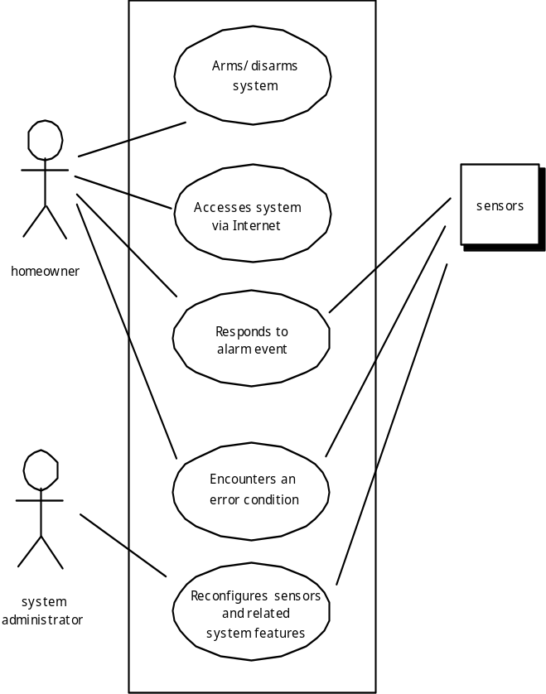
UML Use Case Diagram
These slides are designed to accompany Software Engineering: A Practitioner’s Approach, 7/e (McGraw-Hill, 2009). Slides copyright 2009 by Roger Pressman.

Slide 21
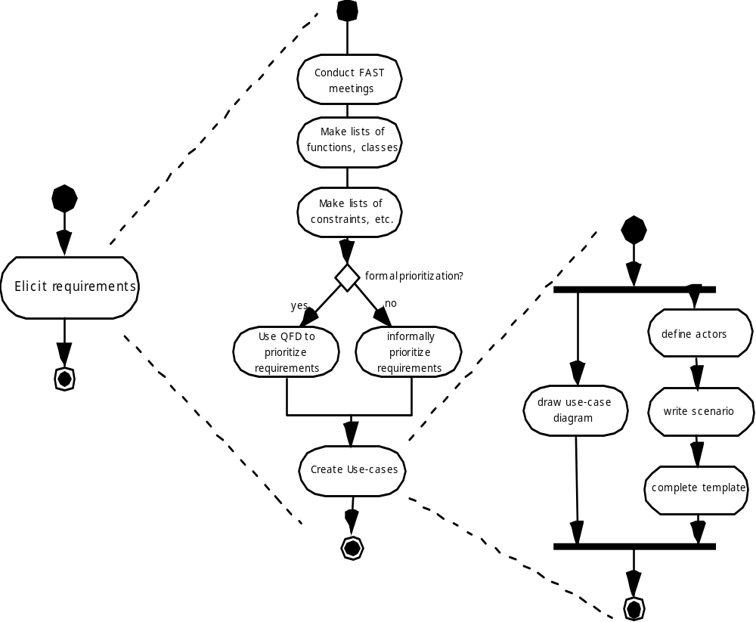
UML Activity Diagrams Eliciting Requirements
These slides are designed to accompany Software Engineering: A Practitioner’s Approach, 7/e (McGraw-Hill, 2009). Slides copyright 2009 by Roger Pressman.

Slide 22
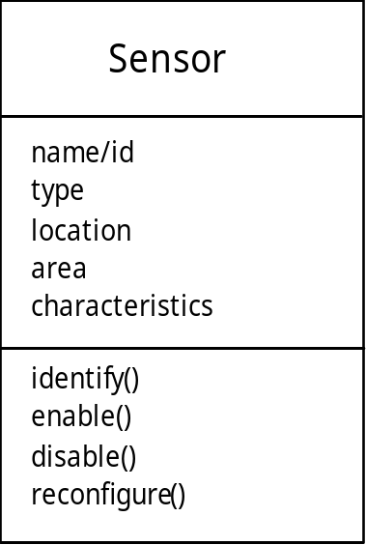
Class Diagram
From the SafeHome system …
These slides are designed to accompany Software Engineering: A Practitioner’s Approach, 7/e (McGraw-Hill, 2009). Slides copyright 2009 by Roger Pressman.

Slide 23
UML State Diagram
Reading
Commands
State name
System status = “ready”
Display msg = “enter cmd”
Display status = steady
State variables
Entry/subsystems ready
Do: poll user input panel
Do: read user input
Do: interpret user input
State activities
software embedded within control panel that is responsible for reading user input.
These slides are designed to accompany Software Engineering: A Practitioner’s Approach, 7/e (McGraw-Hill, 2009). Slides copyright 2009 by Roger Pressman.

Slide 24
Analysis Patterns: to Reuse Solutions
  Pattern name: A descriptor that captures the essence of the pattern.
  Intent: Describes what the pattern accomplishes or represents
  Motivation: A scenario that illustrates how the pattern can be used to address the problem.
  Forces and context: A description of external issues (forces) that can affect how the pattern is used and also the external issues that will be resolved when the pattern is applied.
  Solution: A description of how the pattern is applied to solve the problem with an emphasis on structural and behavioral issues.
  Consequences: Addresses what happens when the pattern is applied and what trade-offs exist during its application.
  Design: Discusses how the analysis pattern can be achieved through the use of known design patterns.
  Known uses: Examples of uses within actual systems.
  Related patterns: On e or more analysis patterns that are related to the named pattern because (1) it is commonly used with the named pattern; (2) it is structurally similar to the named pattern; (3) it is a variation of the named pattern.
These slides are designed to accompany Software Engineering: A Practitioner’s Approach, 7/e (McGraw-Hill, 2009). Slides copyright 2009 by Roger Pressman.

Slide 25
Negotiating Requirements
Even after inception, elicitation and elaborations, customer requirements are still not sufficient in details to proceed to next activity.
Stakeholders need to balance functionality, performance and other product or system characteristics against cost and time-to-market.
Thus, negotiation is to develop a project plan that meets stakeholder needs while at the same time reflecting the real-world constraints such as time, people and budget.
Identify the key stakeholders
  These are the people who will be involved in the negotiation
Determine each of the stakeholders “win conditions”
  Win conditions are not always obvious
Negotiate
  Work toward a set of requirements that lead to “win-win” for all concerned including the software team.
These slides are designed to accompany Software Engineering: A Practitioner’s Approach, 7/e (McGraw-Hill, 2009). Slides copyright 2009 by Roger Pressman.

Slide 26
Art of Negotiation
Recognize that is is not a competition. To be successful, both parties have to feel they’ve won and achieved something. Both will have to compromise.
Map out a strategy. Decide what you want to achieve and what the other party wants to achieve and how you will go about making both happen.
Listen actively. Do not work on formulating your response while the other party is talking. Listen and better negotiate your position.
Focus on the other party’s interest. Do not take hard position if you want to avoid conflicts.
Do not let it get personnel. Focus on the problem.
Be creative. Do not be afraid of think out of the box if you are at an impasse.
Be ready to commit. Once an agreement has been reached, do not waffle, commit to it and move on.
These slides are designed to accompany Software Engineering: A Practitioner’s Approach, 7/e (McGraw-Hill, 2009). Slides copyright 2009 by Roger Pressman.

Slide 27
Validating Requirements - I
Is each requirement consistent with the overall objective for the system/product?
Have all requirements been specified at the proper level of abstraction? That is, do some requirements provide a level of technical detail that is inappropriate at this stage?
Is the requirement really necessary or does it represent an add-on feature that may not be essential to the objective of the system?
Is each requirement bounded and unambiguous?
Does each requirement have attribution? That is, is a source (generally, a specific individual) noted for each requirement?
Do any requirements conflict with other requirements?
These slides are designed to accompany Software Engineering: A Practitioner’s Approach, 7/e (McGraw-Hill, 2009). Slides copyright 2009 by Roger Pressman.

Slide 28
Validating Requirements - II
Is each requirement achievable in the technical environment that will house the system or product?
Is each requirement testable, once implemented?
Does the requirements model properly reflect the information, function and behavior of the system to be built.
Has the requirements model been “partitioned” in a way that exposes progressively more detailed information about the system.
Have requirements patterns been used to simplify the requirements model. Have all patterns been properly validated? Are all patterns consistent with customer requirements?
These slides are designed to accompany Software Engineering: A Practitioner’s Approach, 7/e (McGraw-Hill, 2009). Slides copyright 2009 by Roger Pressman.

